Slide 1

Smart Energy Consumption Analysis and Prediction Using Machine Learning with Device-Level Insights
A comprehensive machine learning approach to intelligent energy monitoring and optimization
- MOHAMED NABIL HUSSAIN Z

Slide 2
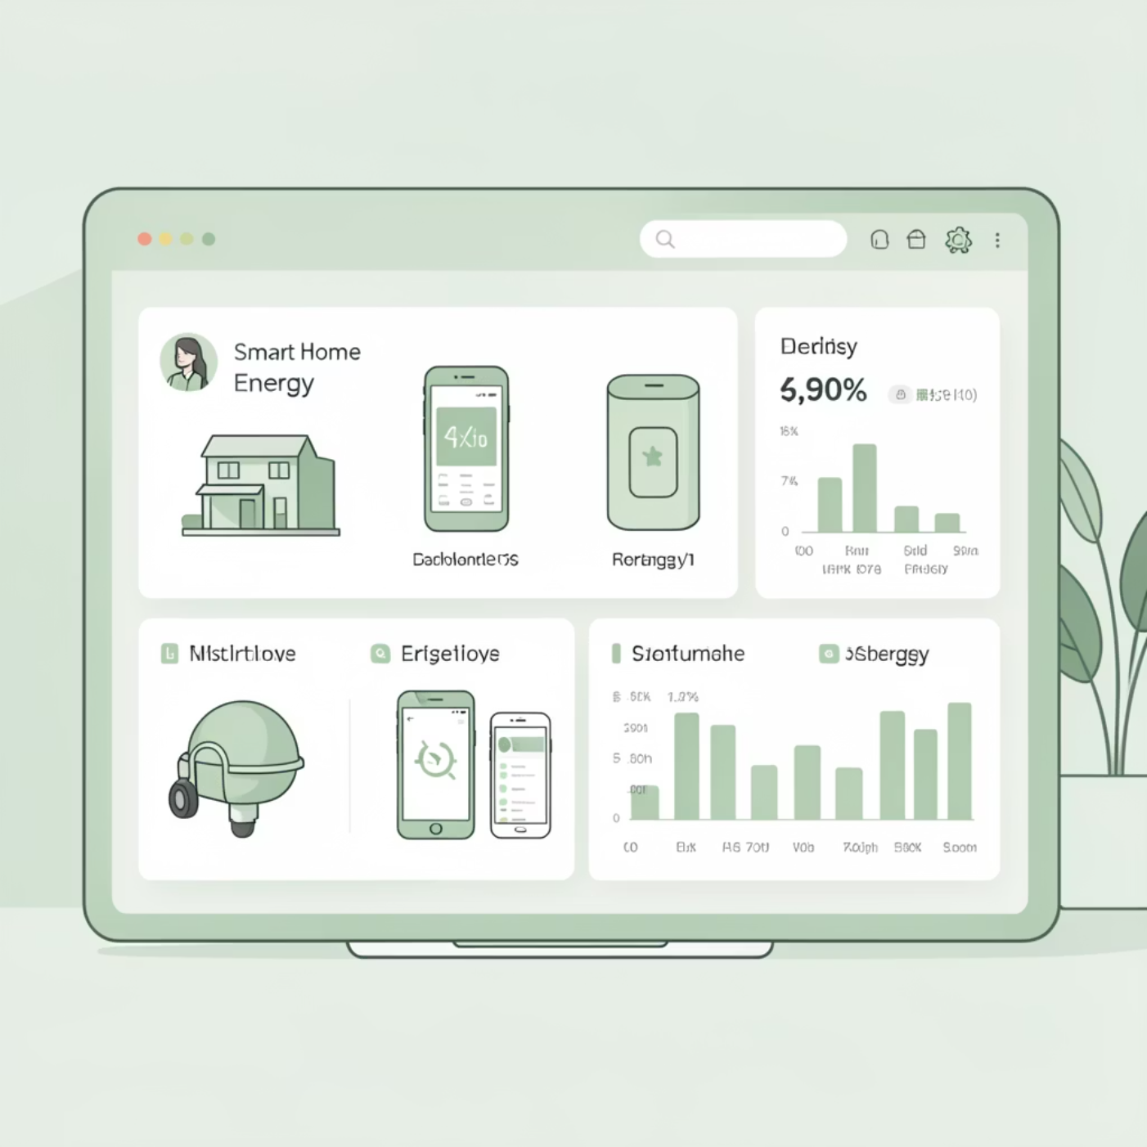
PROJECT OVERVIEW
Intelligent Energy Monitoring for Smart Homes
Objective
This project leverages machine learning to analyze and predict smart home energy consumption patterns at the device level. Using the Kaggle Home_C.csv dataset, we develop real-time forecasting capabilities that enable intelligent monitoring and energy optimization.
Key Goals
Analyze energy consumption patterns
Build accurate predictive models using LSTM networks
Generate device-level insights for optimization
Enable real-time energy forecasting

Slide 3






TECHNOLOGY STACK
Technologies Used
Deep Learning
TensorFlow / Keras
LSTM model development and training
Backend API
Flask
REST API and ML model integration
Frontend
HTML / CSS / JavaScript
Interactive web dashboard interface
Data Processing
Pandas & NumPy
Data manipulation and preprocessing
Visualization
Matplotlib
Data and model visualization
ML Utilities
Scikit-learn
Preprocessing and evaluation tools

Slide 4
DATA ENGINEERING
Data Preprocessing & Feature Engineering Pipeline
01
02
Data Cleaning
Temporal Conversion
Handled missing values, timestamp gaps, and statistical outliers to ensure data quality and consistency
Converted timestamps to datetime format and resampled data to hourly and daily intervals
03
04
Feature Engineering
Sequence Preparation
Created temporal features (hour, day, week, month), lag features (1, 24, 48 hours), and rolling averages
Transformed time-series data into supervised learning sequences for LSTM training

Slide 5
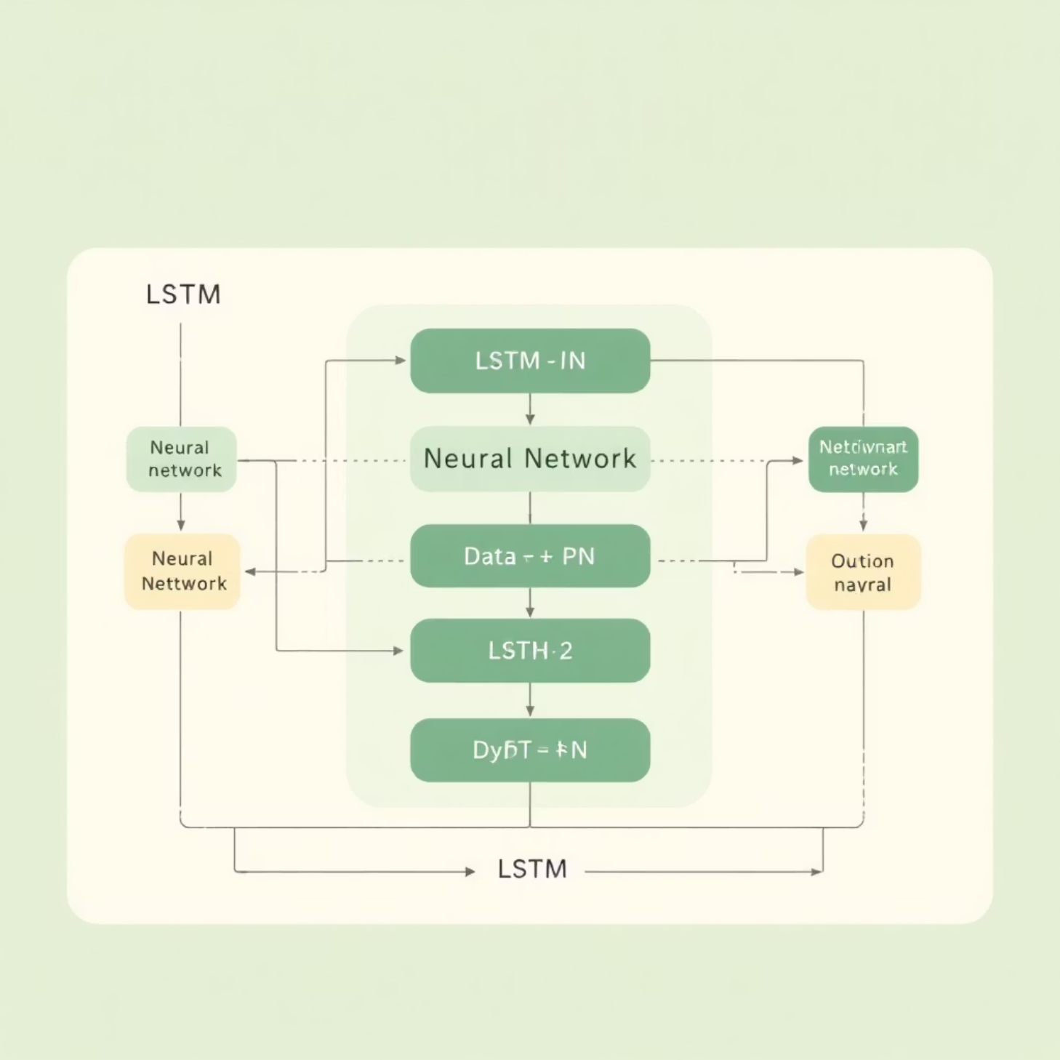
MODEL ARCHITECTURE
LSTM Model Design
Sequence Configuration
The model uses a 48-hour lookback window to capture temporal dependencies in energy consumption patterns. Each sequence contains past energy readings that inform the prediction of the next hour's consumption.
Network Architecture
Input Layer: 48 timesteps of energy data
LSTM Layer 1: 64 units with return sequences
LSTM Layer 2: 32 units
Dense Output: Single value (next-hour prediction)

Slide 6

TRAINING PROCESS
Model Training & Optimization
Optimizer
Adam – Adaptive learning rate optimization for efficient convergence
Loss Function
Mean Absolute Error (MAE) – Robust metric for energy prediction accuracy
Baseline Comparison
Compared LSTM performance against Linear Regression to demonstrate improvement

Slide 7
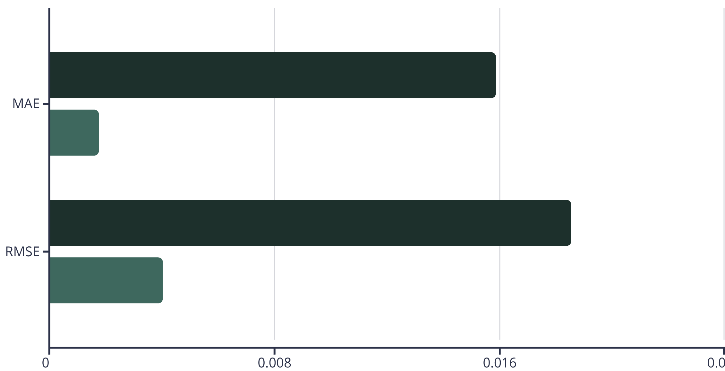
MODEL PERFORMANCE
Results & Evaluation
Model Performance Comparison
Linear Regression
LSTM
Error Reduction
Strong Temporal Learning
Real-Time Ready
LSTM achieved significantly lower prediction error compared to baseline Linear Regression
Model demonstrates excellent capability to capture complex time-series patterns
Performance metrics validate suitability for energy forecasting applications

Slide 8
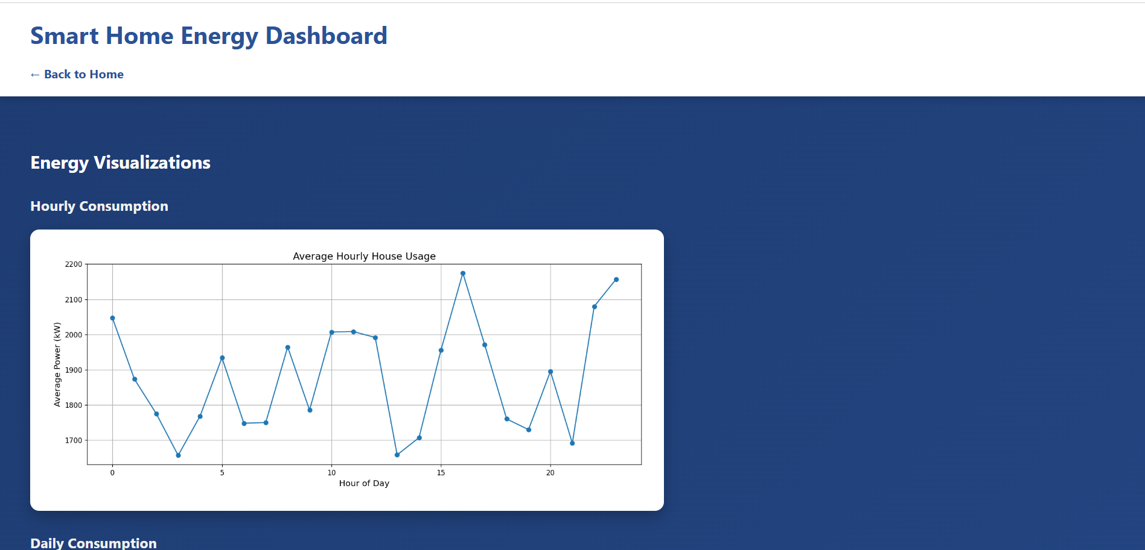
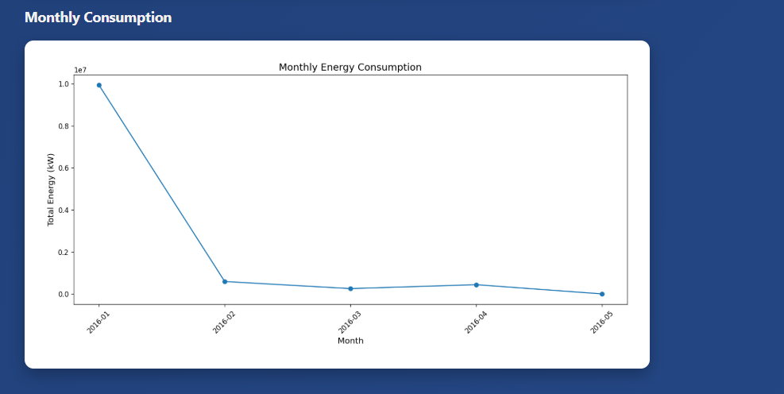
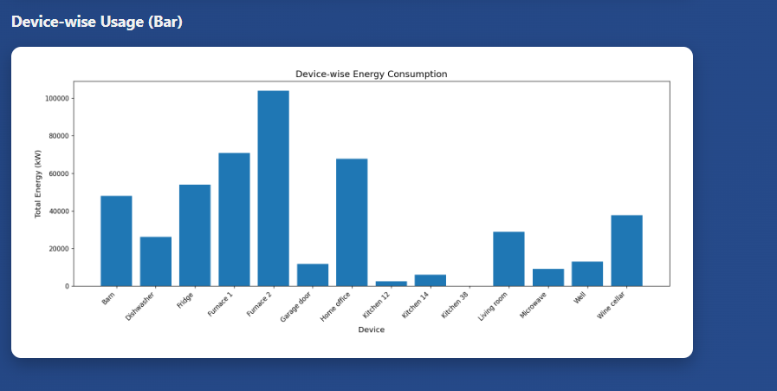
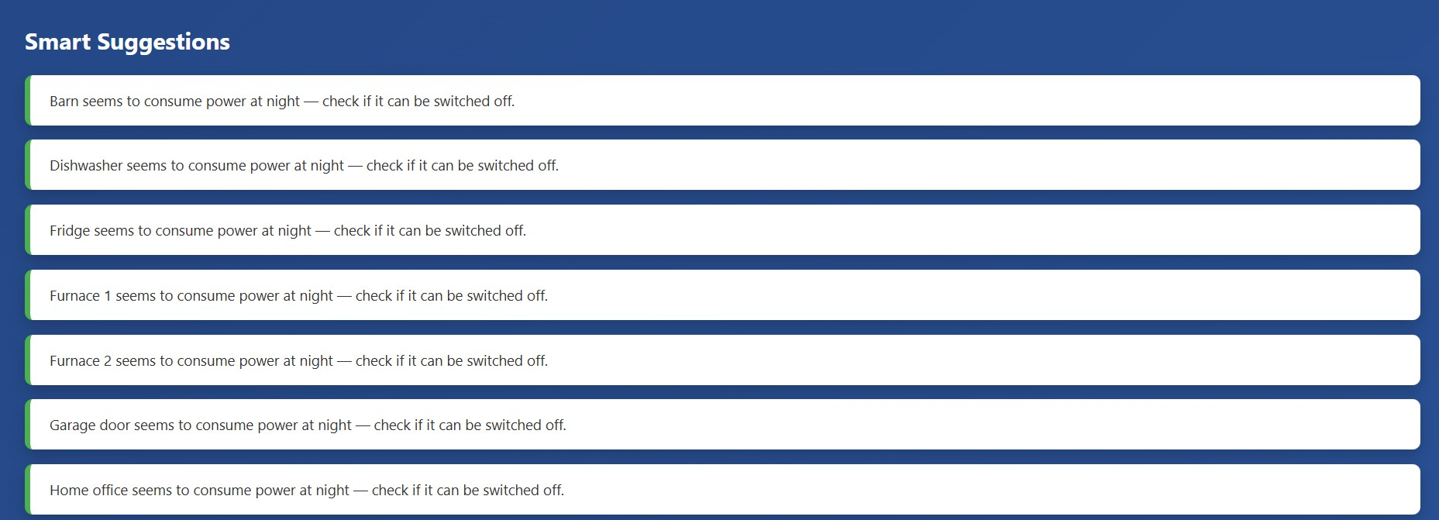
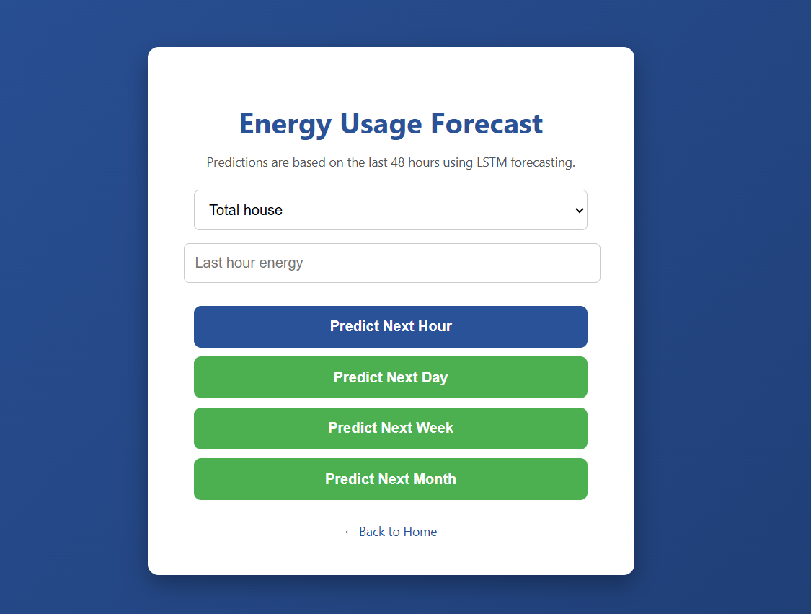
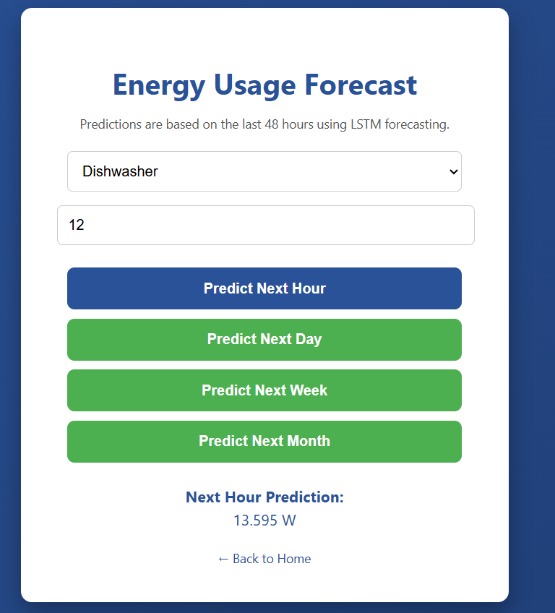
WEB APPLICATION
Flask Web Application Features
Core Capabilities
The Flask-powered web application provides a comprehensive energy management platform with real-time prediction capabilities and interactive analytics.
Real-Time Prediction API
RESTful endpoints for instant energy forecasting
Device-Level Analytics
Granular insights for individual appliances
Multi-Timeframe Dashboards
Hourly, daily, weekly, and monthly views
Smart Recommendations
Smart energy-saving suggestions

Slide 9
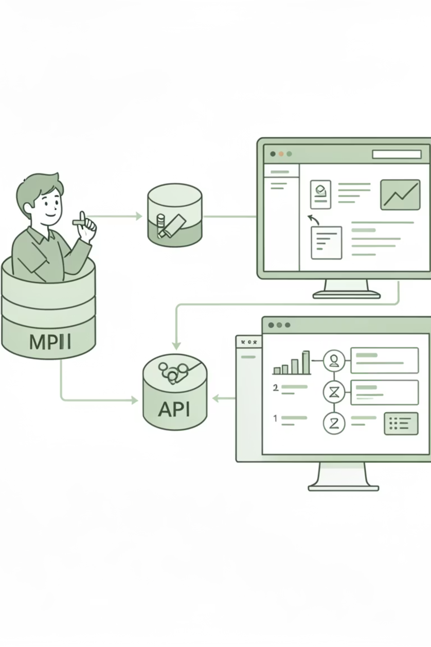



SYSTEM DESIGN
System Architecture & Outputs
Frontend Interface
Dashboards for energy monitoring, forecasting, and optimization recommendations
Model Storage
Trained LSTM model, StandardScaler, and LabelEncoder persisted for inference
Flask Backend
Loads model, processes API requests, generates predictions and visualizations

Slide 10

CONCLUSION
Future Enhancements & Conclusion
Next Steps
1
Cloud Deployment
Scale system using AWS or GCP infrastructure
2
IoT Integration
Connect live sensors for real-time data streams
3
Mobile Platform
Develop native iOS and Android applications
4
https://drive.google.com/drive/u/0/folders/1URBIDigw3x61_zgymSsy7HlOB9lJ34zB
Project demonstration –
Thank You
Questions?

